Slide 1

Cosmos DB

Slide 2

NoSQL Database
Before moving to Cosmos DB, let check what is NoSQL database
NoSQL are non-relational
NoSQL databases have dynamic schemas for unstructured data
NoSQL is better for unstructured data like JSON

Slide 3
Why should go with Cosmos DB ?
High-Throughput
Low Latency
Global Distribution
Multi Consistency Model
Support for different kind of APIs

Slide 4
Cosmos DB
Paas (Platform as a service)
Cloud-based NoSQL database
A fully managed, globally distributed NoSQL database service in Microsoft Azure
It provides extremely low latency, high availability, and consistency.
Supports multi-region (Geo) replication

Slide 5
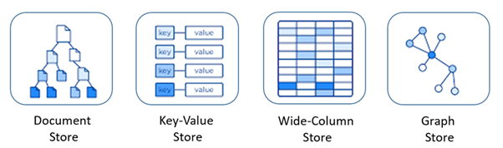
Cosmos database supports multi-model such as

Slide 6
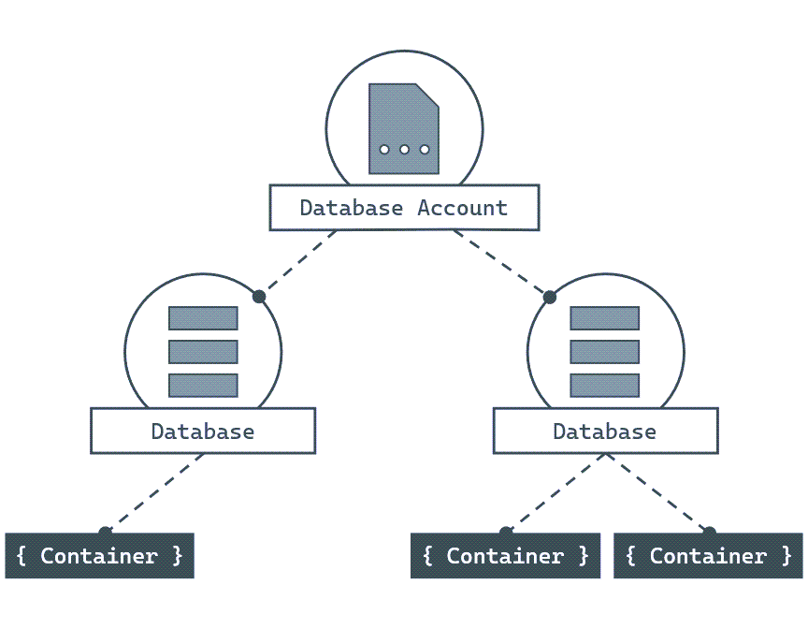
Cosmos DB Architecture

Slide 7
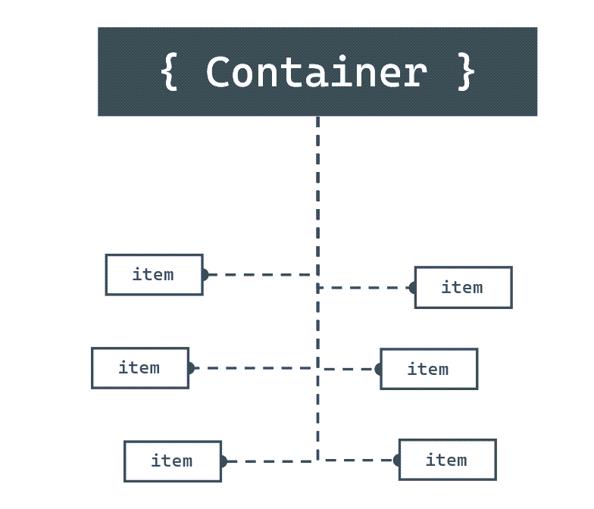
Items

Slide 8
What is a JSON document?
{
"device": {
"type": "mobile"
},
"sentTime": "2019-11-12T13:08:42",
"spoolRefs": [
"6a86682c-be5a-4a4a-bacd-96c4d1c7ece6",
"79e78fe2-93aa-4688-89db-a7278b034aa6"
]
}

Slide 9
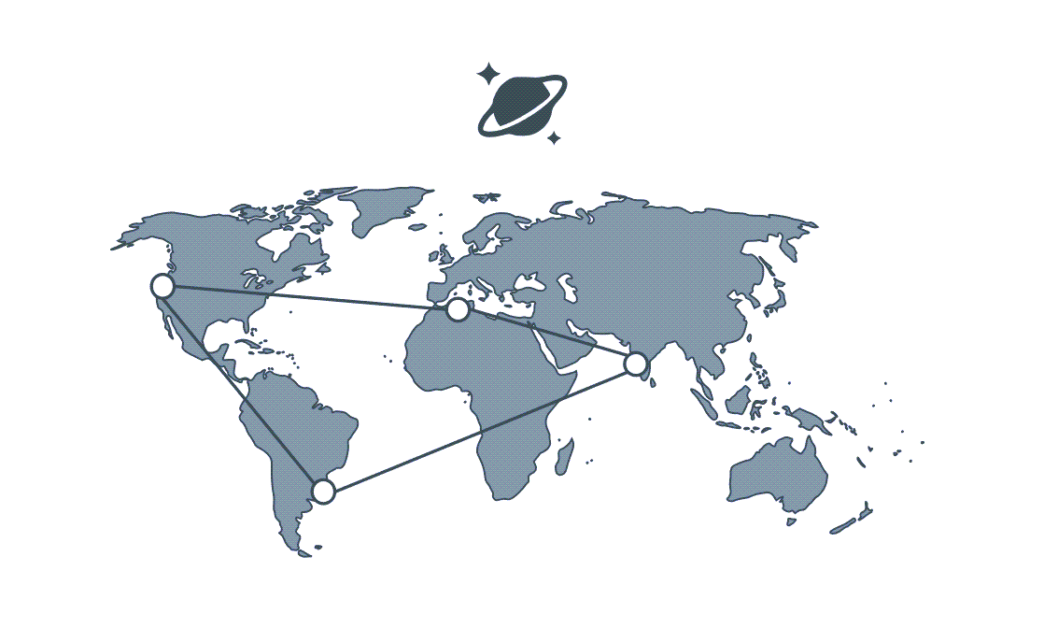
Globally Distributed

Slide 10
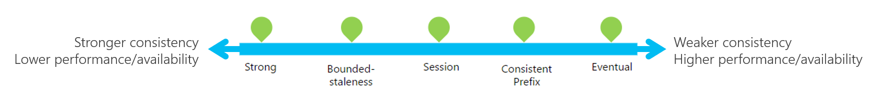
Consistency Levels

Slide 11
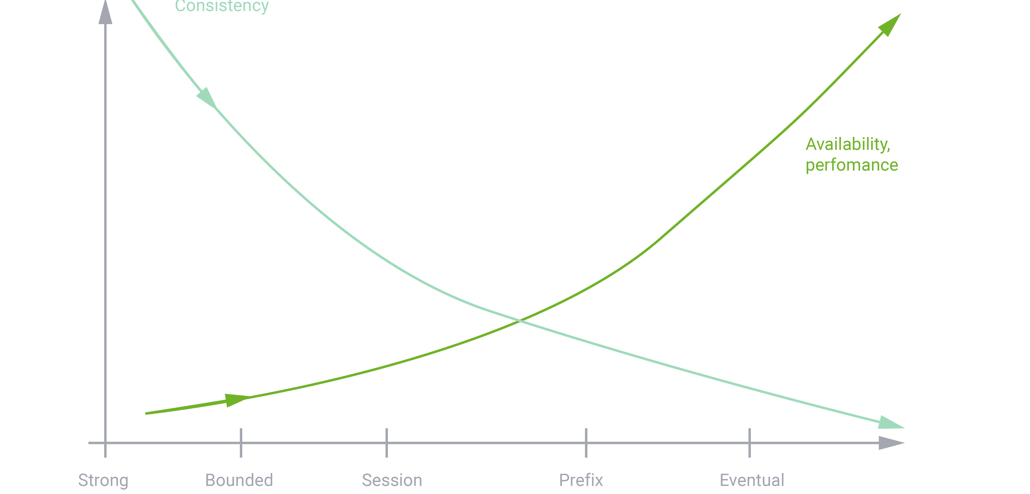
Consistency Levels

Slide 12
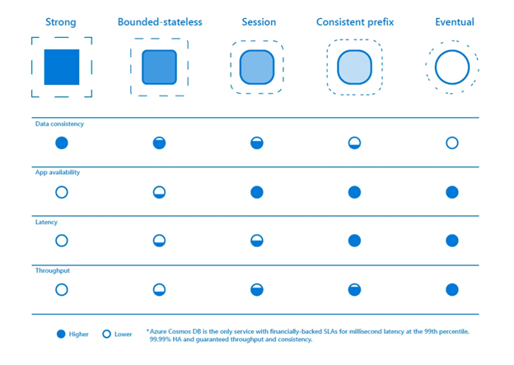
Consistency Levels

Slide 13
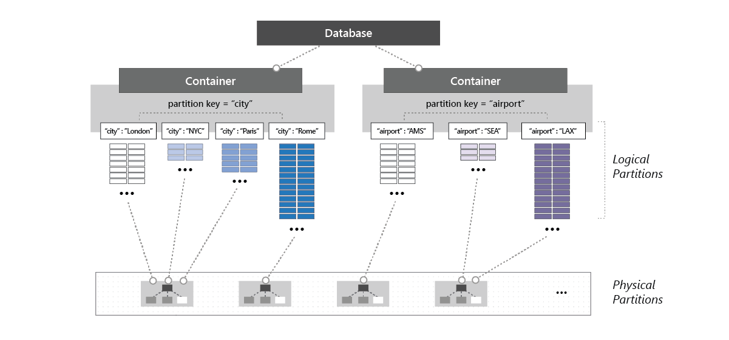
Partitioning

Slide 14
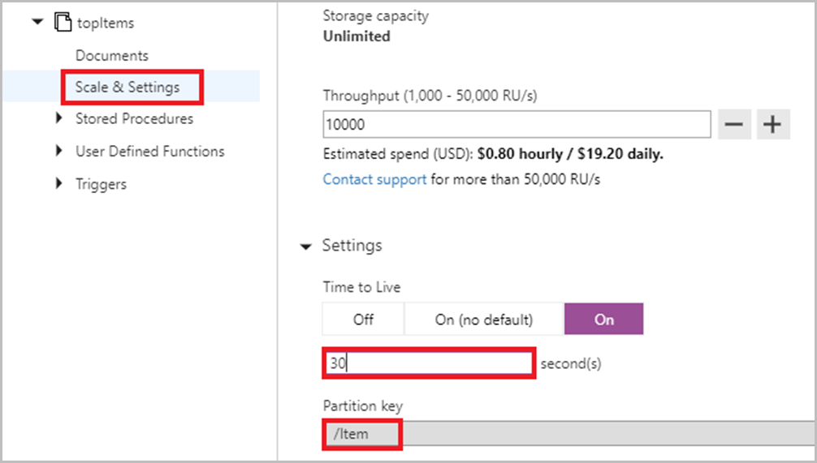
TTL

Slide 15
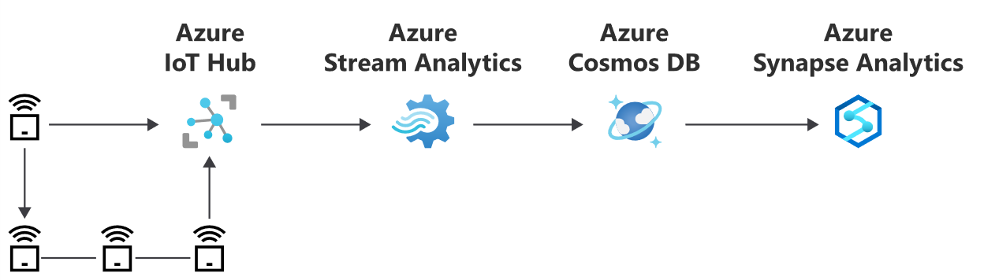
Use Case – IOT / Telemetry

Slide 16
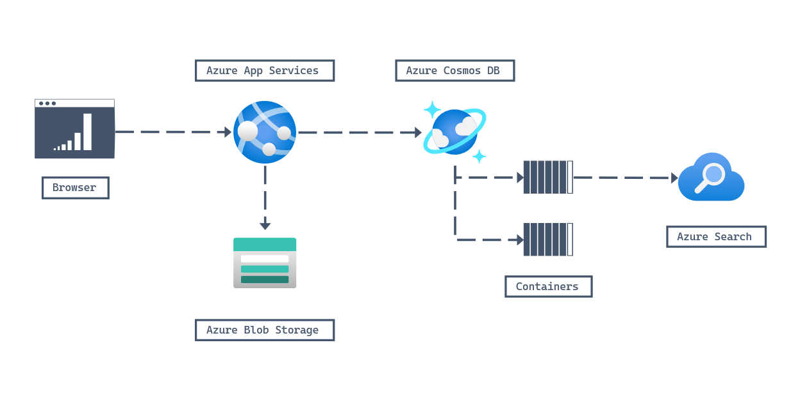
Use Case – Retail/marketing

Slide 17
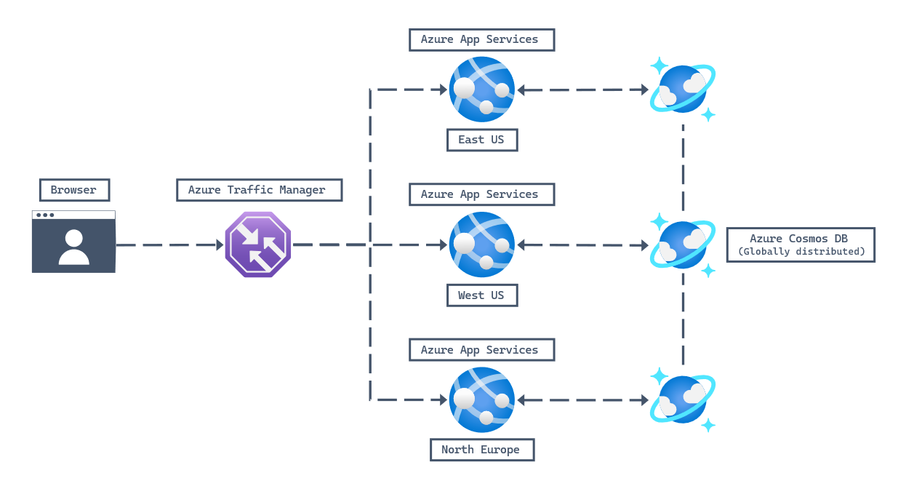
Use Case - Web/mobile

Slide 18
Thank You

